Slide 1

Machine Learning Applications in Dynamical Systems
Zheng-Meng Zhai
Dissertation Defense
03/04/2026
Committee chair:
Prof. Ying-Cheng Lai
Committee members:
Prof. Oliver Kosut
Prof. Shan Lin
Prof. Taejoon Kim

Slide 2

Outline
Motivation: Machine learning and data limitation
Methods: Meta-learning for dynamical systems
Results
Test on synthetic data
Test on real data
Conclusion

Slide 3
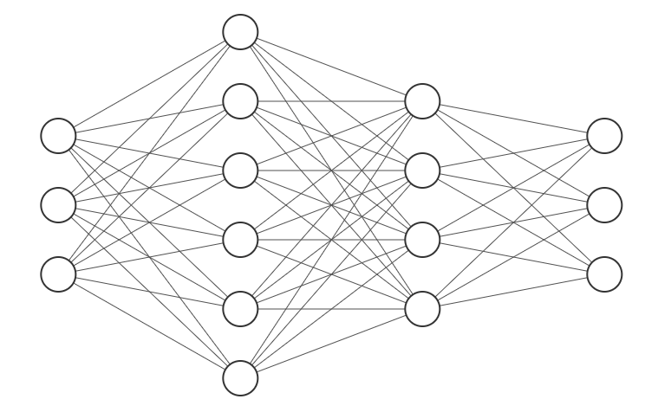



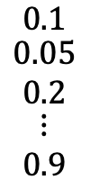
Motivation
Neural networks
z
$$φ(K)$$
$$\begin{matrix}0.1 \\ \begin{aligned}0.05 \\ 0.2\end{aligned} \\ \begin{aligned}⋮ \\ 0.9\end{aligned}\end{matrix}$$
$$φ=$$
y
x
$$φ(0)$$

Slide 4
Motivation
Neural networks
z
$$φ(K)$$
$$\begin{matrix}0.1 \\ \begin{aligned}0.05 \\ 0.2\end{aligned} \\ \begin{aligned}⋮ \\ 0.9\end{aligned}\end{matrix}$$
$$φ=$$
y
x
$$φ(0)$$

Slide 5
Motivation
Neural networks
z
$$φ(K)$$
$$\begin{matrix}0.1 \\ \begin{aligned}0.05 \\ 0.2\end{aligned} \\ \begin{aligned}⋮ \\ 0.9\end{aligned}\end{matrix}$$
$$φ=$$
y
x
Reptile
$$φ(0)$$
[1] Nichol, Alex, Joshua Achiam, and John Schulman. "On first-order meta-learning algorithms." arXiv preprint arXiv:1803.02999 (2018).

Slide 6
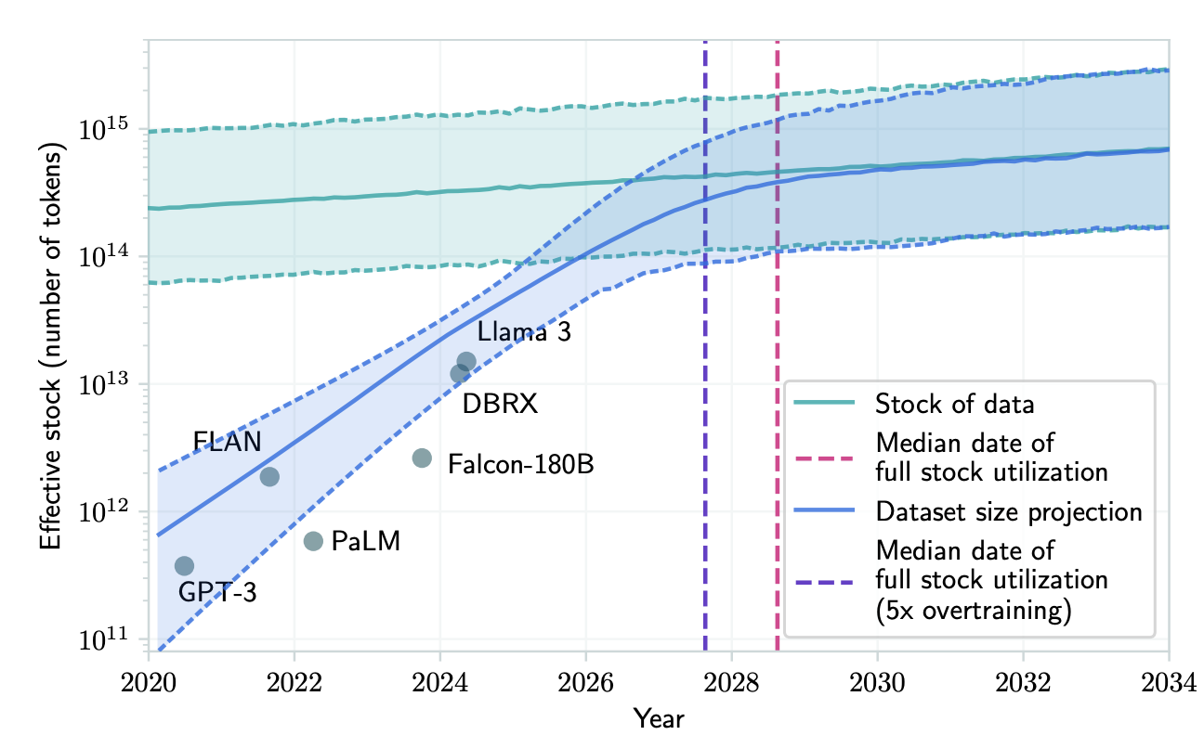
Machine Learning is Data Hungry
[1] Villalobos, Pablo, et al. "Will we run out of data? Limits of LLM scaling based on human-generated data." arXiv preprint arXiv:2211.04325 (2022).

Slide 7
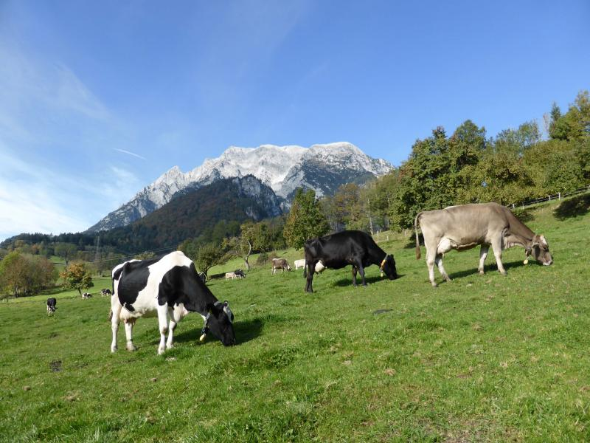
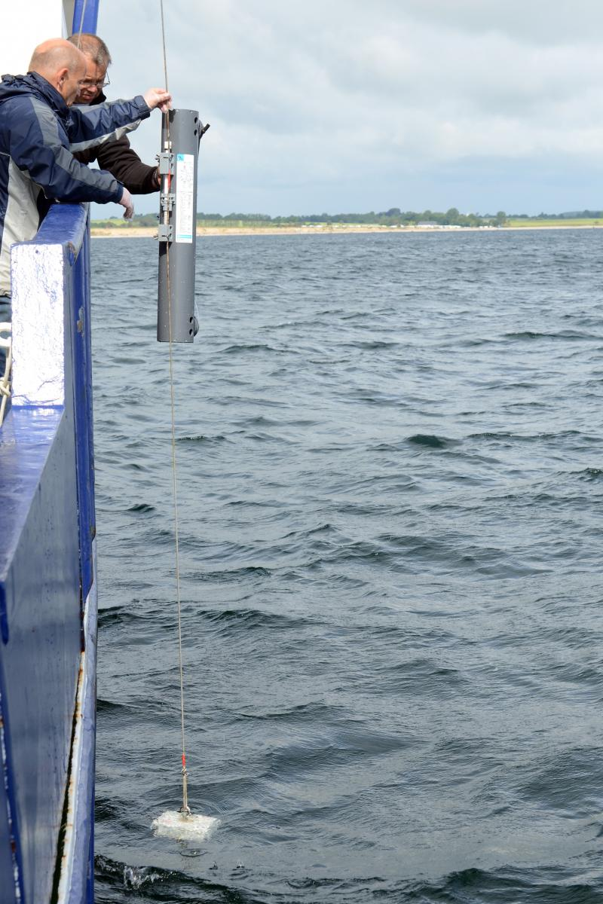
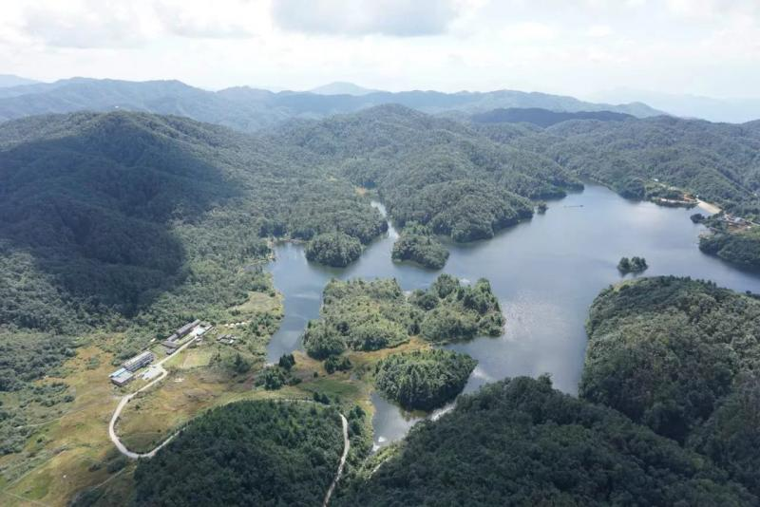
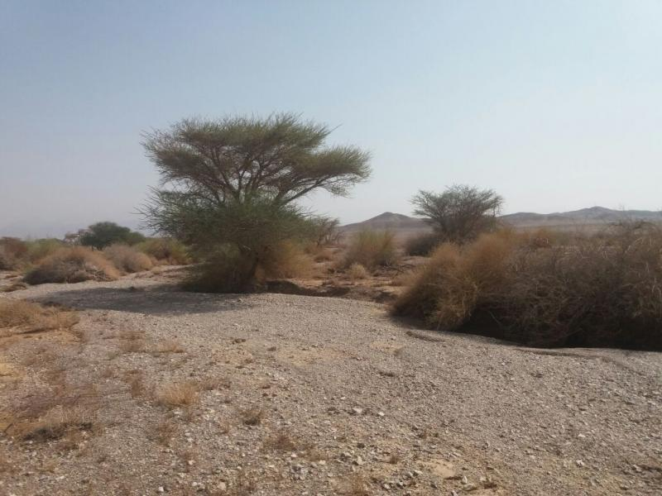
Examples of Ecological Systems
[1] https://deims.org/search/sites
[2] https://library.fiveable.me/biostatistics/unit-16/time-series-analysis-ecological-data/study-guide/qG9OHk49MeCsFWjQ

Slide 8
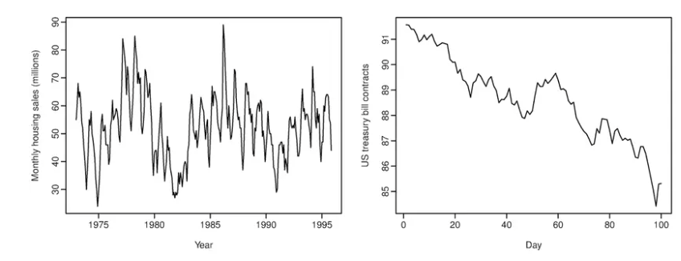
Machine Learning for Ecological Systems
Limited amount of data points!
[1] https://deims.org/search/sites
[2] https://library.fiveable.me/biostatistics/unit-16/time-series-analysis-ecological-data/study-guide/qG9OHk49MeCsFWjQ

Slide 9
Machine Learning Methods for Ecological Systems
Species classification: D. R. Cutler, T. C. Edwards Jr, K. H. Beard, A. Cutler, K. T. Hess, J. Gibson, and J. J. Lawler, Random forests for classification in ecology, Ecology 88, 2783 (2007).
Predicting species invasions: J. M. Drake, C. Randin, and A. Guisan, Modelling ecological niches with support vector machines, J. Appl. Ecol. 43, 424 (2006).
Species recognition from video and audio analysis: D. Tuia, B. Kellenberger, S. Beery, B. R. Costelloe, S. Zuffi, B. Risse, A. Mathis, M. W. Mathis, F. van Langevelde, T. Burghardt, et al., Perspectives in machine learning for wildlife conservation, Nat. Commun. 13, 792 (2022).
Data leakage in ecological systems: A Stock, EJ Gregr, KMA Chan, Data leakage jeopardizes ecological applications of machine learning, Nat. Ecol. Evol. 7, 11 (2023)
Generative AI with ecology: K. Rafiq, S. Berry, M. S. Palmer, Z. Harchaoui, and B. Abrahms, Generative AI as a tool to accelerate the field of ecology, Nat. Ecol. Evol. 9, 3, (2025).
Limitations: paucity of the observational or measurement data.

Slide 10
Meta-learning: Learning-to-learn Paradigm
Computer vision: Y.-X. Wang, D. Ramanan, and M. Hebert, Meta-learning to detect rare objects, in Proceedings of the IEEE/CVF International Conference on Computer Vision (2019) pp. 9925–9934.
Time series forecasting: T. S. Talagala, R. J. Hyndman, and G. Athanasopoulos, Meta-learning how to forecast time series, J. Forecast. 42, 1476 (2023).
Reinforcement learning: A. Nagabandi, I. Clavera, S. Liu, R. S. Fearing, P. Abbeel, S. Levine, and C. Finn, Learning to adapt in dynamic, real-world environments through meta reinforcement learning, arXiv preprint arXiv:1803.11347 (2018).
Identification of special quantum states: C-D. Han, C.-Z. Wang, and Y.-C. Lai, Meta-machine learning-based quantum scar detector, Phys. Rev. Appl. 19, 064042 (2023).
Internet of things: L. You, Z. Guo, C. Yuen, C. Y.-C. Chen, Y. Zhang, and H. V. Poor, A framework reforming personalized Internet of Things by federated meta-learning. Nat. Commun., 16.1, (2025).
Meta learning is designed for data-limited problems.

Slide 11
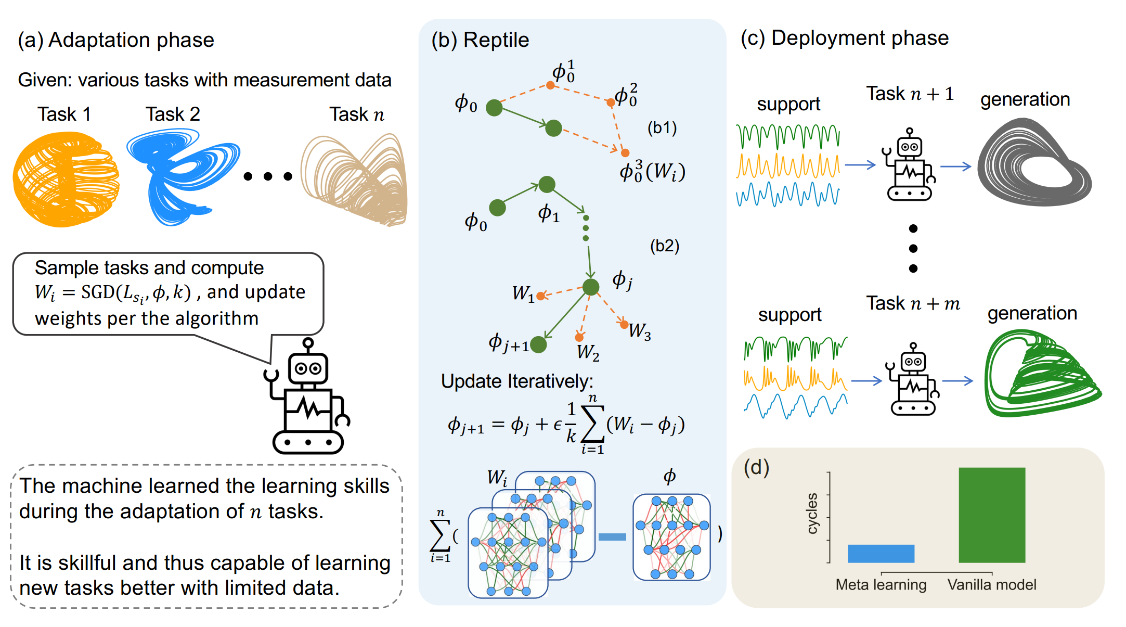
Our work: Learning to Learn Ecosystems from Limited Data
For machine to adapt

Slide 12
Our work: Learning to Learn Ecosystems from Limited Data
We provide only limited data
For machine to adapt
[1] Zhai, Zheng-Meng, et al. "Learning to learn ecosystems from limited data." Proceedings of the National Academy of Sciences 122.51 (2025): e2525347122.

Slide 13
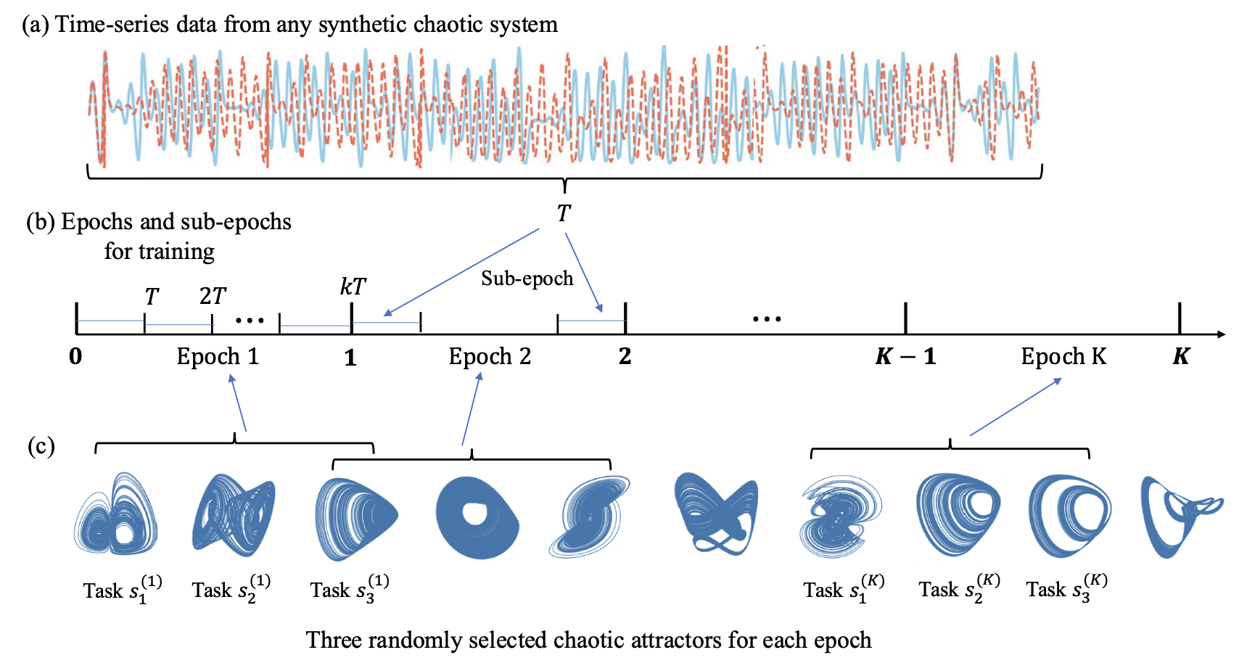
Meta Learning Framework

Slide 14
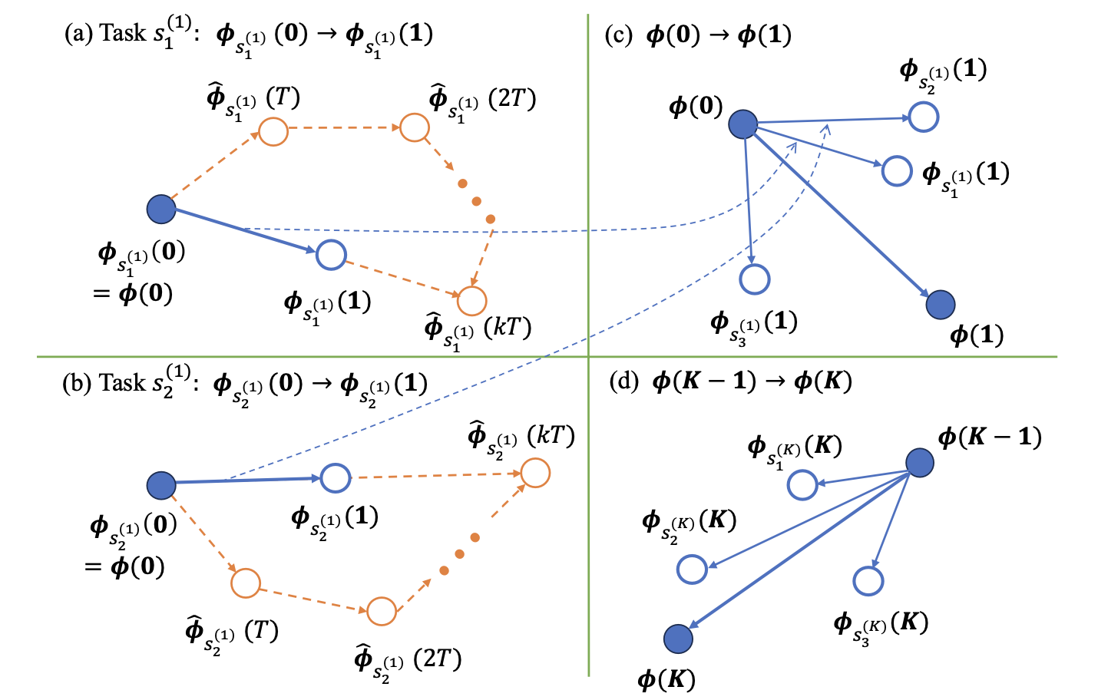
Meta Learning Framework

Slide 15
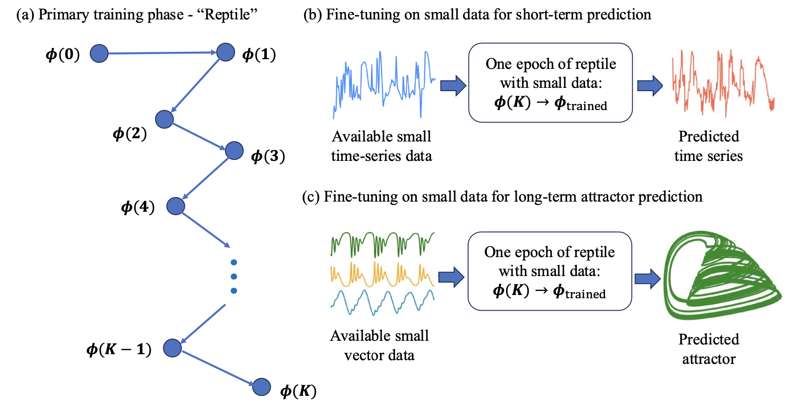
Meta Learning Framework

Slide 16
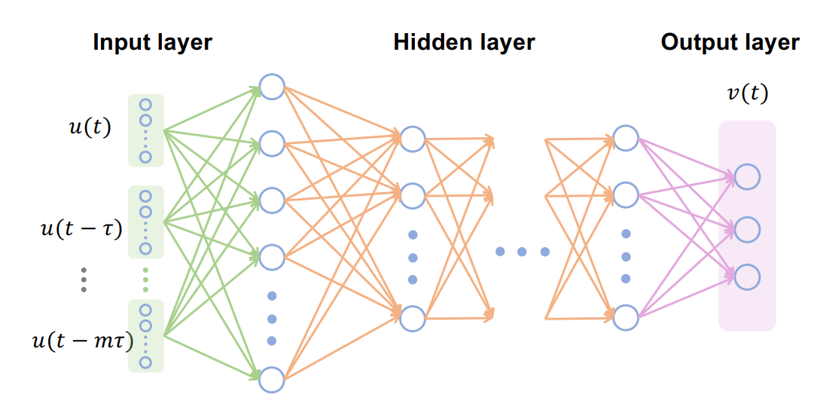
Methods: Next Generation Reservoir Computing
[1] Gauthier, Daniel J., et al. "Next generation reservoir computing." Nature communications 12.1 (2021): 1-8.

Slide 17
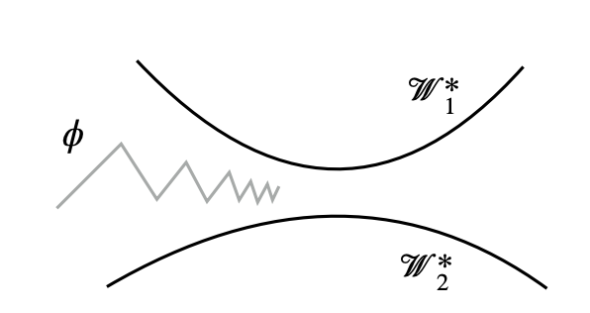
Methods
Reptile
Vanilla model
Meta-learning
The network structure, hyperparameters are all the same!

Slide 18
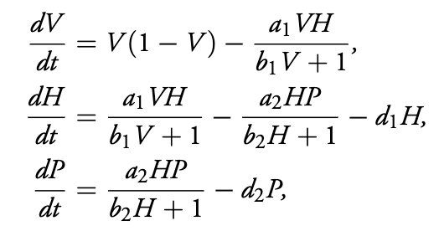
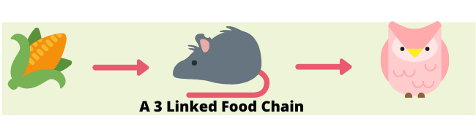
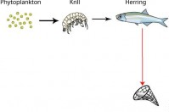
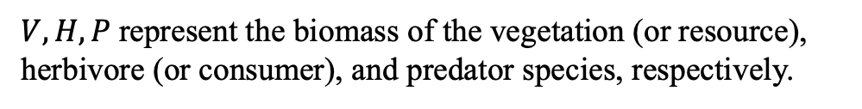
Case Study: Forecasting the Chaotic Hastings-Powell System
$V, H, P$represent the biomass of the vegetation (or resource), herbivore (or consumer), and predator species, respectively.
[1] Hastings, Alan, and Thomas Powell. "Chaos in a three‐species food chain." Ecology 72.3 (1991): 896-903.
[2] http://sciencebitz.com/?page_id=470

Slide 19
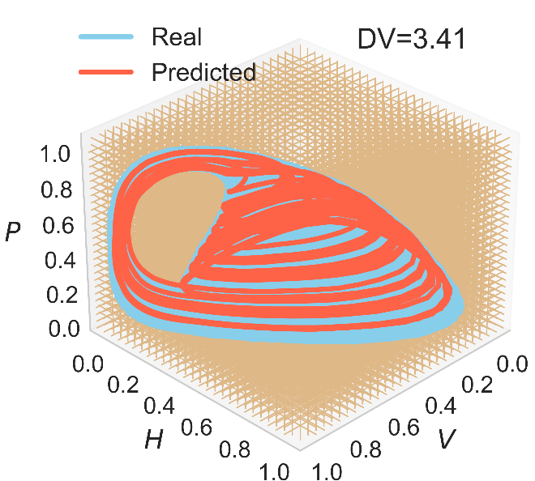
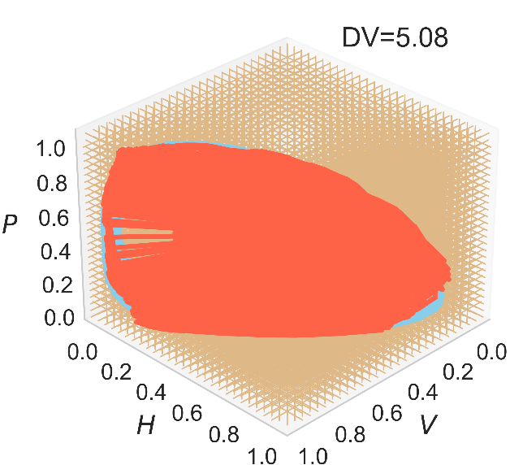
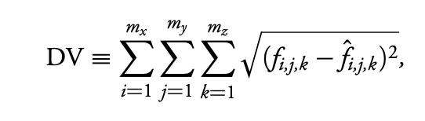
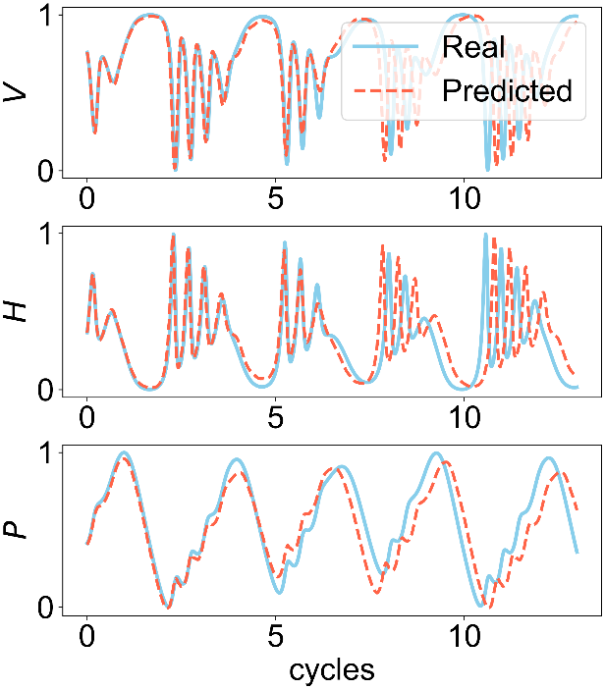
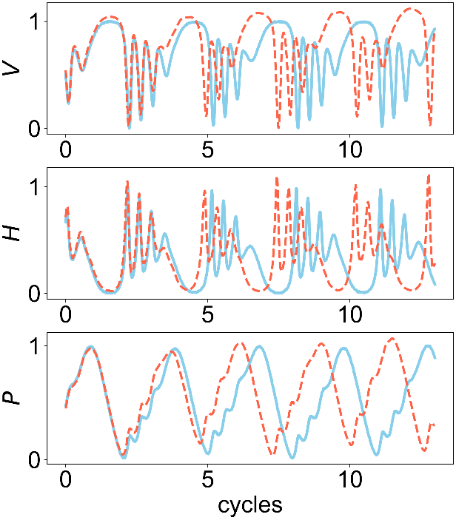
Results: Predictions by Meta-learning and Vanilla Frameworks
Meta learning
Vanilla model
We use the same neural network structure to make predictions with the same settings, but one with meta-learning and the other not.

Slide 20
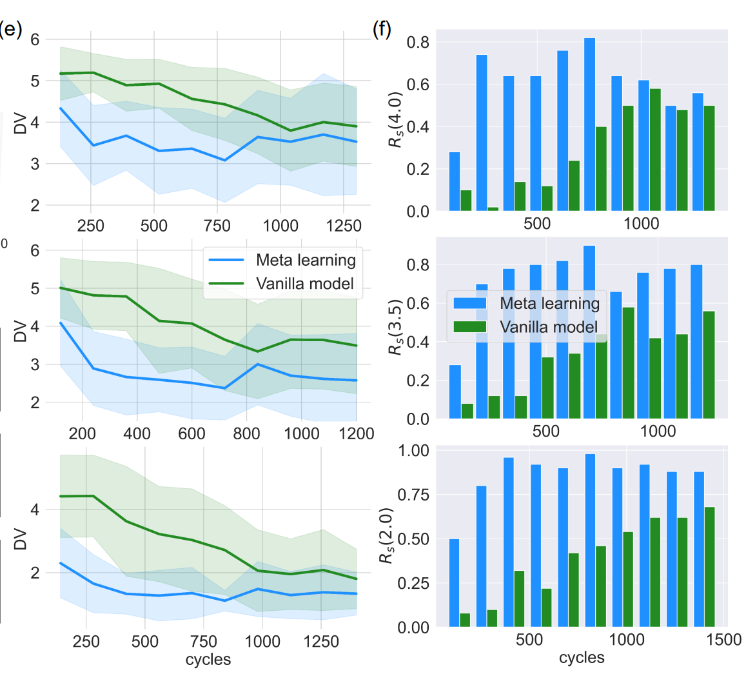
Results: Predictions by Meta-learning and Vanilla Frameworks
Meta learning
Vanilla model
Number of cycles

Slide 21
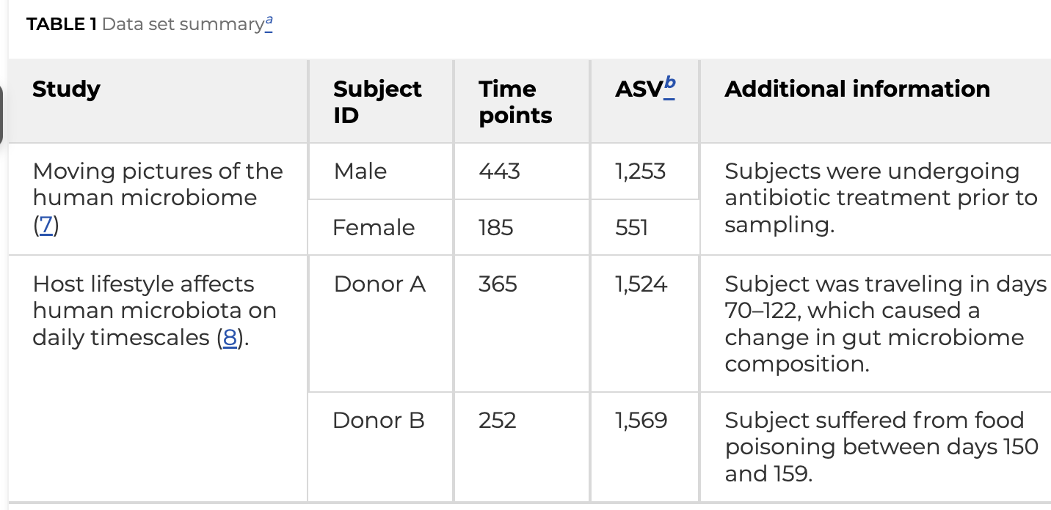
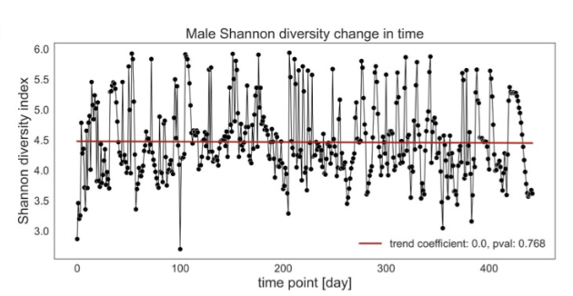
Case Study: Forecasting the Gut Microbial Dataset
[1] Karwowska, Zuzanna, et. al. "Microbiome time series data reveal predictable patterns of change." Microbiology Spectrum 12.10 (2024): e04109-23.

Slide 22
Case Study: Forecasting the Gut Microbial Dataset
We provide only limited data
For machine to adapt
From synthetic to real data!

Slide 23
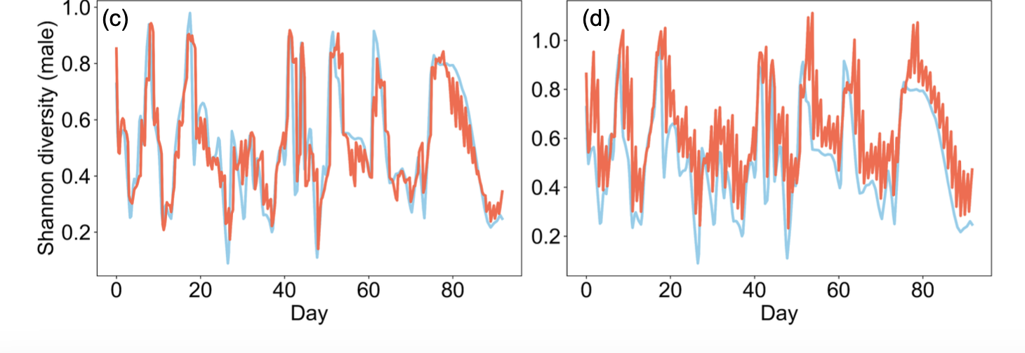
Result: Forecasting the Gut Microbial Dataset
Exemplified prediction
Meta learning
Vanilla model

Slide 24
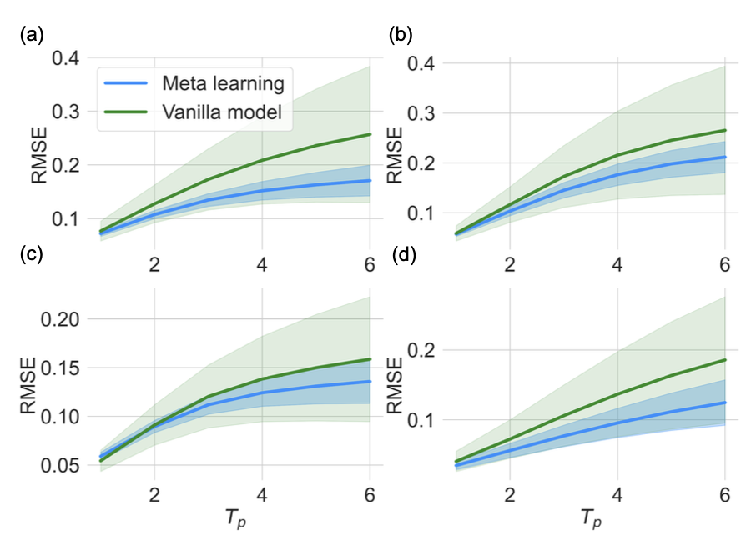
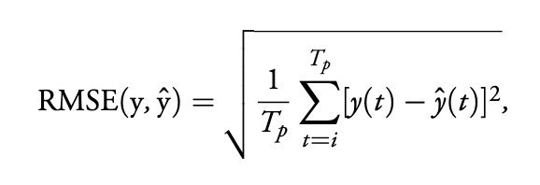
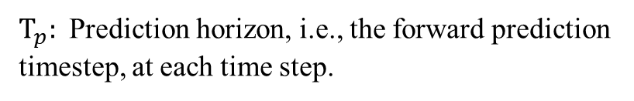
Result: Forecasting the Gut Microbial Dataset
$T_{p}:$ Prediction horizon, i.e., the forward prediction timestep, at each time step.

Slide 25
Conclusion

Slide 26
Publications
[15] Zheng-Meng Zhai, Bryan Glaz, Mulugeta Haile, Alan Hastings, and Ying-Cheng Lai, ‘‘Learning to learn ecosystems from limited data,’’ PNAS, 122, e2525347122, 1-9 (2025).
[14] Shirin Panahi, Zheng-Meng Zhai, Mulugeta Haile, and Ying-Cheng Lai, ‘‘Neuromorphic reservoir computing,’’ Chaos, 35, 123144, (2025).
[13] Zheng-Meng Zhai, Benjamin D. Stern, and Ying-Cheng Lai, ‘‘Bridging known and unknown dynamics by transformer-based machine-learning inference from sparse observations,’’ Nature Communications, 16, 8053, 1-12 (2025).
[12] Zheng-Meng Zhai, Mohammadamin Moradi, and Ying-Cheng Lai, ‘‘Detecting attacks and estimating states of power grids from partial observations with machine learning,’’ PRX Energy 4, 013003, 1-22 (2025).
[11] Mohammadamin Moradi, Zheng-Meng Zhai, Shirin Panahi, and Ying-Cheng Lai. ‘‘Adaptive network approach to exploration-exploitation trade-off in reinforcement learning,’’ Chaos 34, 123120, 1-14 (2024).
[10] Shirin Panahi, Ling-Wei Kong, Mohammadamin Moradi, Zheng-Meng Zhai, Bryan Glaz, Mulugeta Haile, and Ying-Cheng Lai. ‘‘Machine learning prediction of tipping in complex dynamical systems,’’ Physical Review Research 6, 043194, 1-18 (2024).
[9] Zheng-Meng Zhai, Mohammadamin Moradi, Shirin Panahi, Zhi-Hua Wang, and Ying-Cheng Lai. ‘‘Machine-learning nowcasting of the Atlantic Meridional Overturning Circulation,’’ APL Machine Learning, 2, 036103 (2024).

Slide 27
Publications
[8] Mohammadamin Moradi, Shirin Panahi, Zheng-Meng Zhai, Yang Weng, John Dirkman, and Ying-Cheng Lai. ‘‘Heterogeneous reinforcement learning for defending power grids against attacks,’’ APL Machine Learning, 2, 026121 (2024).
[7] Mohammadamin Moradi, Zheng-Meng Zhai, Aaron Nielsen, and Ying-Cheng Lai. ‘‘Random forests for detecting weak signals and extracting physical information: A case study of magnetic navigation,’’ APL Machine Learning, 2, 016118 (2024).
[6] Zheng-Meng Zhai, Mohammadamin Moradi, Bryan Glaz, Mulugeta Haile, and Ying-Cheng Lai. ‘‘Machine-learning parameter tracking with partial state observation,’’ Physical Review Research, 6, 013196, 1-19 (2024).
[5] Zheng-Meng Zhai, Mohammadamin Moradi, Ling-Wei Kong, Bryan Glaz, Mulugeta Haile, and Ying-Cheng Lai. ‘‘Model-free tracking control of complex dynamical trajectories with machine learning,’’ Nature Communications, 14, 5968, 1-11 (2023). [Highlighted as a Featured Article]
[4] Zheng-Meng Zhai, Ling-Wei Kong, and Ying-Cheng Lai. ‘‘Emergence of a resonance in machine learning,’’ Physical Review Research, 5, 033127, 1-12 (2023).
[3] Zheng-Meng Zhai, Mohammadamin Moradi, Ling-Wei Kong, and Ying-Cheng Lai. ‘‘Detecting Weak Physical Signal from Noise: A Machine-Learning Approach with Applications to Magnetic-Anomaly-Guided Navigation,’’ Physical Review Applied, 19, 034030, 1-18 (2023).

Slide 28
Publications
[2] Yong-Shang Long, Zheng-Meng Zhai, Ming Tang, Ying Liu, and Ying-Cheng Lai. ‘‘Structural position vectors and symmetries in complex networks,’’ Chaos, 32, 093132, 1-24 (2022). [Featured in Scilight]
[1] Yong-Shang Long, Zheng-Meng Zhai, Ming Tang, and Ying-Cheng Lai. ‘‘Metamorphoses and explosively remote synchronization in dynamical networks,’’ Chaos, 32, 043110, 1-10 (2022).

Slide 29
Thank you!

